Slide 1
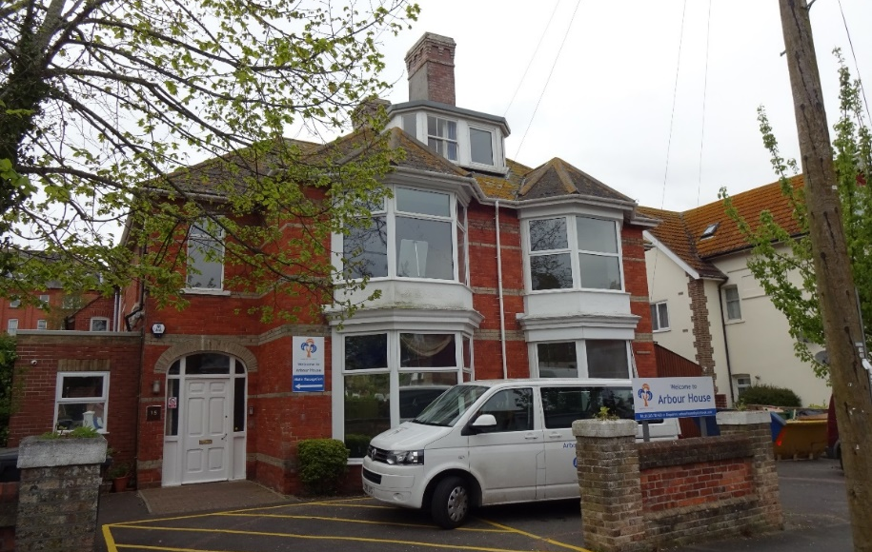
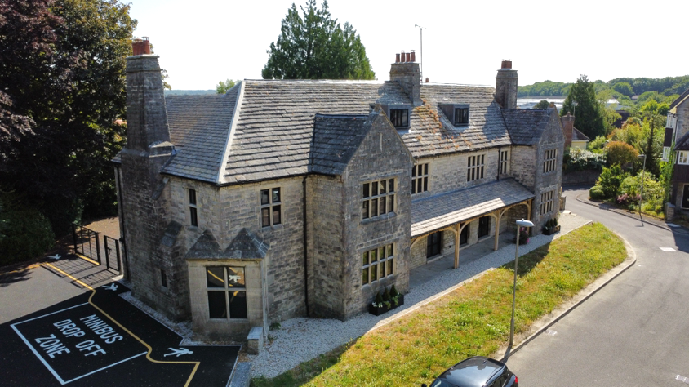
Arbour House School How We Assess Pupils and Measure Progress

Slide 2
Where Do We Start?
Unlike many other schools we are a commissioned or ‘purchased’ service.
The Local Authority buy places with us, for an agreed annual fee.
When we receive referrals, SEN Leads or Commissioning Teams make clear in their initial referral paperwork what it is exactly that the Local Authority want to buy.
This has a direct impact on what we deliver and the service that we provide. Noone wants to buy apples and receive pears instead!
The LA need evidence that what we have delivered is exactly what they have purchased.
This is reviewed annually with parent/carers, children, and SEN Leads, in Education, Health and Care Plan (EHCP) Annual Reviews.
So our starting point for all children is the Desired Outcomes of their EHCP.

Slide 3
Desired Outcomes in EHCP’s are:
The Local Authority’s Key Performance Indicators (KPI’s) for our provision
The parent/carer’s overarching wishes and aspirations for their child for the future
The child or young person’s own hopes and ambitions for their future
Children, their parents/carers, and the Local Authority are our Key Stakeholders.
Pupils’ EHCP Desired Outcomes form a key part of our monitoring and assessment of children, because it is important that we assess ourselves against what it is that those key stakeholders have asked us to provide i.e. what
it is that we have been commissioned to do.

Slide 4
An EHCP is a child’s ’Long Term’ plan. It has 12 Sections. Section E is the ‘Outcomes’ section.
An Outcome of an EHCP can be defined as the benefit or difference made as a result of an intervention.
EHCP Outcomes should:
Change and adapt throughout the life of an EHCP to reflect the changing needs and progress of the child/YP. person
Be SMART
(specific, measurable, achievable, realistic, time-bound).
Can be divided into short-term and long-term
Last until the end of the academic year/key stage/next stage of education.
Reviewed and updated as necessary at each Annual Review of the EHCP.
In order to assess and evaluate whether the Local Authority have secured good outcomes for a child they require us to evidence pupils’ progress annually against the Outcomes of their EHCP.
Are we doing what we said we would do? Are we providing what has been purchased and agreed?
To what effect i.e. what is the impact? Has a benefit or difference been made to the child as a result of the purchased placement?
Have we delivered value for money?

Slide 5
What Education Desired Outcomes may look like for our SEN Pupils
Develop my social communication skills so that I can form 2 or 3 positive reciprocal (two-way) friendships
Engage in co-operative activities with a peer to develop and maintain meaningful friendships within school.
Improve my attendance to above 80%.
Successfully transition into the school environment without distress in order to increase my attendance at school and re-engagement with learning
Remain in class and tell a trusted adult how I am feeling so that I can be supported and remain safe.
Consistently form all my letters correctly so that I can develop my written work.
Identify and choose a range of strategies to support myself to calm and regulate and be in a right state for learning.
Identify when I need a drink or am hungry and tell a trusted adult so that I can stay regulated.
Identify my emotions and communicate these to a key adult.

Slide 6
EHCP Outcomes are very individual to each child.
All pupils have different starting points, with different strengths and needs.
What is progress for one child is not necessarily progress for another.
A pupil achieving all of their Maths targets may be exceptional if they struggle with numbers for example, but is not an indication of progress for a pupil who has no issues with meeting any of their academic targets.
A child who cannot communicate with other children, or participate in their community, needs to make entirely different progress than the child struggling with numbers, who can participate and socialise very well…
Each child’s progress against their Outcomes is also wholly individual and so has to be measured and assessed as such.
It may also not be progress with formal curriculum that we have been commissioned by the LA to deliver outcomes for. It may be pupils’ attendance, eating, anxieties, or social interaction and communication that we have been asked to prioritise for a child.
Progress in core curriculum or ‘academic’ progress may not then be a Key Performance Indicator for that child, for our stakeholders, nor for us as a commissioned service.

Slide 7
All pupils with an EHCP also have a termly Individual Education Plan (IEP), so we break down a child’s annual (Long Term) plan into three termly (Medium Term) plans and this gives a child one IEP per term.
Termly IEP’s are submitted to the LA to evidence pupils’ progress against their Desired Outcomes.
Termly IEP’s are reviewed at the end of each term with ‘Emerging’, ‘Developing’ or ‘Secure’ assessments made. This informs target-setting for the following term’s IEP. Targets not met can be carried over.
Pupils can contribute to the target-setting and review of their own IEP’s.
For our pupils 12 weeks (an average school term) is a long time. They need more bitesize targets. So we break down our termly IEP’s into Weekly SMART Targets for them and these are their ‘Short Term’ plans.
Weekly Targets are also monitored. They are marked as ‘Achieved’ or ‘Working Towards’ and they give a much more immediate snapshot of what may be going well and areas where pupils may be struggling.
This supports teachers to be more immediately responsive and supportive, and to adapt learning strategies or take action where necessary.
We understand that not all children can achieve everything every week, so if Weekly Targets have not been achieved, they can also be carried over.

Slide 8
Long-term EHCPs, medium-term IEPs, and short-term Weekly Targets are used to monitor and assess pupils’ progress:
EHCP Outcomes form
the basis of Long-Term Planning
for our Pupils
Medium Term Plan 3
=
Summer Term IEP
Medium Term Plan 1
=
Autumn Term IEP
Medium Term Plan 2
=
Spring Term IEP
Weekly SMART Targets x 12
Weekly SMART Targets x 12
Weekly SMART Targets x 12

Slide 9
Termly IEP’s also allow us to be aspirational for pupils and encourage children to be aspirational for themselves.
Often their Long Term EHCP Outcomes are not hugely ‘academic’ in focus, but more related to improvements in their engagement, participation, and self-regulation.
Whilst these are recognised as important key areas to develop and improve for most of our pupils, when we consulted children directly, Pupil Voice revealed that most of our pupils want opportunities for more ‘academic’ learning.
Pupils said that they want the opportunities that they perceive children in other schools have, to improve their reading, to be able to study Science, or to sit exams for example.
So in creating our IEP’s we aim to ensure that targets set also focus on appropriately ‘academic’ challenges across all core areas of the curriculum.

Slide 10
In order to set meaningful academic targets on IEP’s we need to know what pupils can and can’t do, so we use B-Squared to baseline assess pupils and to better inform their future learning plans. We use:
B-Squared Progression Steps:
This is an observation-based, formative assessment framework for use with pupils who are engaged in subject-specific learning.
It helps teachers to identify and record the ongoing achievements of pupils who are working below age-related expectations in some or all areas of their development.
It can be used with pupils who are studying from a formal curriculum or those engaged in a semi-formal approach to learning.
B-Squared Steps4Life:
a
B-Squared Steps4Life:
Steps 4 Life covers a huge ability range and a wide range of skills.
It is designed to support pupils to Prepare for Adulthood (PFA). It covers
Academic skills: English, Maths, PSD (including Relationship & Sex Education), and Digital Skills;
Life Skills: Food, Independence, Self Care and Travel.
Employability Skills: Identifying a Job, Getting a Job, Your Rights, Workplace Routines, and Workplace Skills.
B-Squared Autism Progress:
Based on SCERTS this is used alongside academic assessment to help profile a pupil’s needs. It has a range of skills spread over a set of progressive levels in 4 areas:
Communication
Flexibility of Thought
Social Interaction
Emotional Regulation
Each area goes from Level 1 (around birth) to Level 17 (early adulthood). It offers a list of strategies for each area and each level to support pupils.
It is useful, even for pupils that do not have Autism, as all of our pupils experience difficulty in at least one of the 4 areas.

Slide 11
We can also use B-Squared’s ‘Phonics for Pupils with SEN’ :
This is a complete, systematic linguistic phonics programme.
It offers an innovative and simple approach to the teaching of phonics, which pupils with special educational needs can easily access.
It enables pupils with a range of special educational needs to find reading and spelling success.
It is suitable for
those with specific learning difficulties
autism
moderate and severe learning difficulties
developmental language disorder
communication needs and complex needs, including pre- and nonverbal pupils
and those with significant physical disability.
we

Slide 12
For our pupils one size does not fit all, and in line with our commitment to offer bespoke learning, some pupils may be following Progression Steps, others may be on the Steps4Life Framework, and some pupils may need a combination of strands from each framework to best meet their needs and to support them to make meaningful progress.
All of our pupils have gaps in their learning, for a range of reasons.
It is a complex task to support filling some of those learning gaps at the same time as continuing to support them to move forward.
Sometimes to best meet pupils’ needs we may need to ‘mix and match’ assessment frameworks.

Slide 13
As part of our commitment to the development of the whole child, we assess and monitor pupils in other key areas too. This helps us to identify where they may need further additional support, and to secure genuinely ‘holistic’ outcomes.
All pupils have termly Thrive Assessments and Thrive Action Plans for example, with Thrive learning objectives set and reviewed each term.
So what is Thrive and why do we use it?
Thrive is a whole school approach that helps to improve the mental health and wellbeing of children..
Thrive has its own online assessment tool called ‘Thrive-Online’. It is a profiling and assessment tool to help staff assess children's social and emotional needs, plan activities to meet those needs, and then track their progress.
Staff use Thrive Action Plans and targets, from Thrive Online, with suggested strategies, to ensure that pupils are given additional support to improve their mental health and well-being.
We have 2 Registered Thrive Practitioners who support all staff to assess pupils termly and to embed the Thrive Approach across the whole school.
We ensure that children’s health and well-being is a priority and Thrive activities are embedded for all pupils throughout the week with Thrive targets included in their termly IEP’s.

Slide 14
Positive Behaviour Targets & Incident Log Analysis:
Many of our pupils are referred to us with ‘behaviours that challenge’ and many of them have experienced a number of exclusions for these behaviours in other settings.
We believe that all behaviour is a form of communication.
As children learn to better self-regulate so they learn to communicate their needs in other, more positive ways. But for many children who have some deeply entrenched behaviours, it can take some time to learn how to express themselves differently, so we track pupils’ behaviour and incidents to give us an indication of the progress they are making with this.
Identifying patterns in incidents also helps us to put supportive measures in place.
We aim not to remove triggers for children, but to support them to better manage their triggers more positively as a skill for life.
All pupils are set Positive Behaviour Targets on their Weekly SMART Target sheets. Teachers can track how many of their Positive Behaviour Targets they are achieving, and use this to measure their progress, but also to modify or adapt their provision if necessary.

Slide 15
Attendance Data & Analysis
Many of our pupils have experienced periods out of school. For some, even if they were able to access a school place, they did not attend regularly. They either refused to attend or were on reduced provision. Many of our pupils have been on part-time timetables for significant periods of time or educated ‘off-site’.
The impact of that is that many of our pupils are out of the habit of attending school regularly or attending for full days. They have become ‘deskilled’ in being able to manage the demands of a school environment or the routines of attending school.
We believe that every child has the right to a full-time education that meets their needs, and as such we do not support part-time timetables beyond initial induction. We aim to support all pupils to attend school every day, for 30 hours a week. For pupils with evidenced medical conditions that cannot do this, we work alongside medical professionals to best support what may work for them, in as bespoke a way as possible.
For lots of our pupils attending every day, 30 hours a week, is a significantly aspirational target, and we understand that this may take time to establish as a pattern or routine for many of our children.
A pupil who has always attended school every day may not face the same challenges as a child who has been out of school for 2 years, a school refuser, or a child who suffers anxiety related to school attendance. To that effect, we monitor all pupils’ attendance and measure their progress against their own individual baseline. We support pupils to make progress in relation to their own starting point, and that varies significantly for individual children.

Slide 16
EHCPs & Pupils’ Desired Outcomes
Termly Individual Education Plans
Weekly SMART Targets
Behaviour Targets & Incident Analysis
Attendance & Exclusion Data
Prior attainment data if available and current
B-Squared Assessment
Thrive Online & Thrive Action Plans
Stakeholder Feedback & Pupil Voice
Pupil Case Studies
We use a variety of interrelated assessments, to ensure that when we measure progress for pupils it is comprehensive, holistic, and reflects the development of the whole child.

